Slide 1

"Empowering Abilities:
Celebrating Employment for People with Disabilities

Slide 2
National employment month for people with disabilities
Raises awareness about the unique skills and talents individuals with disabilities bring to the workforce,
Promote initiatives that reduce employment barriers.
Highlights the importance of creating inclusive workplaces and providing equal job opportunities for all.

Slide 3
objectives
Benefits of employment
Rates of Employment
New York State and The Center for Family Supports’ commitment to improving employment outcomes for the people we support.
Types of services available
Open discussion

Slide 4
What are some benefits to employment?

Slide 5
BENEFITs OF EMPLOYMENT
Employment offers significant financial and social benefits.
Source of Income
Financial Independence
Inclusion
Increased Self Esteem
Community Engagement
Develop meaningful relationships
Social Roles

Slide 6
Employment stats
Access to jobs remain unequal!!
U.S. Employment Statistics:
  19.1% of individuals with disabilities were employed in 2022.
  63.7% of individuals without disabilities were employed during the same period
New York State Statistics:
  35% of individuals with disabilities in NY are employed
  65% of those without disabilities are employed
Barriers include discrimination, lack of employment opportunities and accessibility challenges.

Slide 7
New York State
Employment First State (2014)
What is Employment First?
A policy commitment to making employment the first and preferred option for individuals with disabilities.
Focuses on developing opportunities for all New Yorkers with disabilities to achieve meaningful employment.

Slide 8
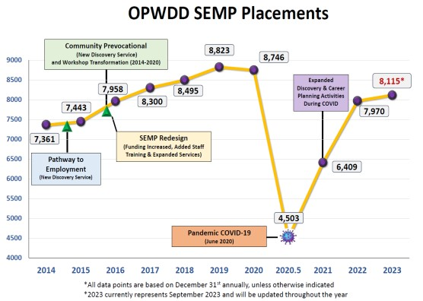

Slide 9
CFS MISSION
CFS is dedicated to meeting NY State's Employment First mandate by expanding employment opportunities and support.
Goal:
Promote independence through meaningful employment Help the people we support achieve long-term employment success.

Slide 10
What are your employment goals?
What skills do you need to gain and maintain employment?

Slide 11
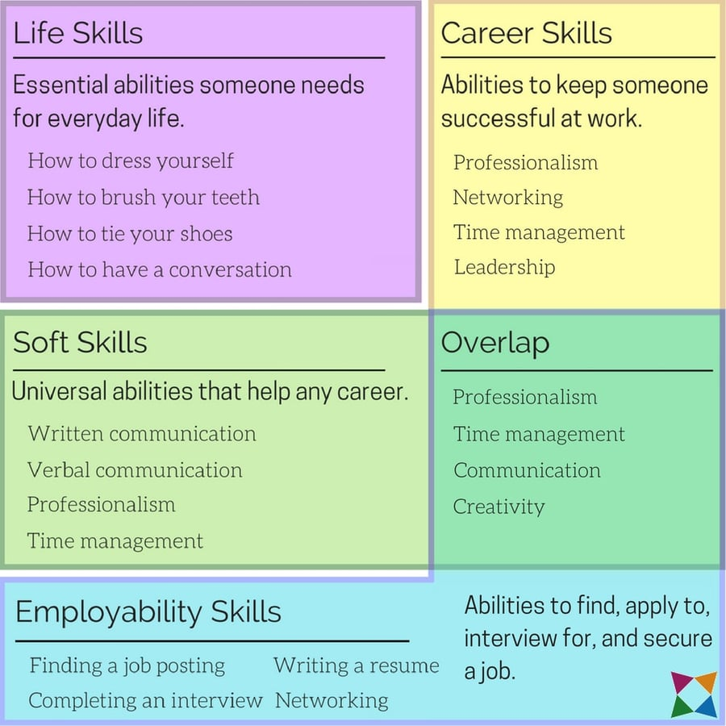

Slide 12
“Pathways to employment” through supports and services
Life Skills
  Day Habilitation/Community Habilitation
Employability Skills
  Community Based Prevoc
  Pathways to Employment
  Employment Training Program (ETP)
  Supported Employment

Slide 13
What’s happening at CFS?
Present Program Offerings
Day Habilitation/Community Habilitation
Supported Employment
New Program Offerings
Community-Based Prevocational Services
ETP-Employee Training Program

Slide 14
Day habilitation
Structured activities focusing on skill-building and personal development.
Key Features:
Activities that promote social interaction and inclusion.
Skill Developments May Include Academic, Time Management, Traveling, Communication and Socialization, Health and Safety and Money Management
Can include vocational training to enhance independence and readiness for employment.
.
Benefits:
Enhances daily living skills and prepares individuals for future employment opportunities.
Fosters a sense of community and belonging.

Slide 15
Community Habilitation
Program objective to help participants develop skills and achieve greater independence.
Key Features:
  Services are tailored to the individual's needs and goals, focusing on skill development in daily living, socialization, and community integration.
  Skill Development Areas: Areas may include personal care (personal hygiene, dressing etc.), communication, cooking, budgeting, and community engagement.
Benefits:
  Enhances quality of life and fosters independence.
  Encourages participation in community activities and social interactions.
  Provides opportunities for individuals to build relationships and develop social skills.

Slide 16
Extended Supported Employment
Designed for individuals who already have a job.
Provides ongoing support to ensure job retention and satisfaction.
Focus on helping individuals maintain employment and grow in their careers.
Key Features:
Job coaching, advocacy, and on-site support.
Encourages self-sufficiency in the workplace.
May also be used to assist individuals to maintain their own business.

Slide 17
CBPV
Community-Based Prevocational Services
What is Prevocational Service?
A preparatory program aimed at preparing participants for competitive integrated employment through the development of work readiness skills. (skills building)
Focus on areas such as improving communication, social skills, time management, and task completion.
Community-Based Approach:
Emphasizes skills development in real-world community settings rather than in simulated environments.
Group and Individualized support
  Job Club
  Discovery
Volunteer Opportunities

Slide 18
ETP-Employee Training Program
What is the Employee Training Program?
Provides hands-on training to enhance specific work-related skills.
Participants engage in tailored training (paid internship) that prepares them for specific jobs or industries.
Helps individuals develop competencies to transition into competitive employment.
Focus Areas:
Paid internship with aim to lead to competitive employment
Job matching based on individual interests and skills.
Collaboration with local businesses to create internship and job placement opportunities.

Slide 19
Questions/Comments

Slide 20
CONTACT US
Diana Collins-dcollins@cfsny.org
Danielle Powers-dpowers@cfsny.org ​
Cristina Perera- cperera@cfsny.org
Tamiko Hill-thill@cfsny.org
Yolanda Rodriguez- yrodriguez@cfsny.org

