Slide 1
FINANCIAL EDUCATION
MONEY
MANAGEMENT
TIMOTHY ELLIOTT

Slide 2


FINANCIAL EDUCATION
What will be covered?
I. Budgeting & Saving
II. PASS PLAN
III. 55-b program

Slide 3
I. BUDGETING
What Is A Budget?
Is simply a breakdown of how much money you have coming in (income) & where it goes (expenses).
Is a financial plan you lay out for you & your family that helps you control your spending while working toward a goal.
Is written, whether it’s pencil & paper or a spreadsheet on a computer.
Is done monthly, but should be viewed & worked on weekly, sometimes daily.

Slide 4
TRACKING YOUR INCOME
* Includes earned income from employment or a business.
* Includes unearned income such as Social Security benefits, pensions, dividends, interest, retirement, alimony, child support, food stamps, gifts.
TRACKING YOUR EXPENSES
* Fixed – Monthly expenses that are the same every month & rarely change. EXAMPLES:
- RENT or Mortgage - Fixed, not Adjustable-Rate Mortgage (ARM)
- Car Payments
- Loans
- Cell phone (plan)
- Cable
* Variable – Monthly expenses that change on a monthly basis & are rarely the same. EXAMPLES:
- Credit Cards (Depending on usage)
- Utilities
- Transportation
- Food

Slide 5
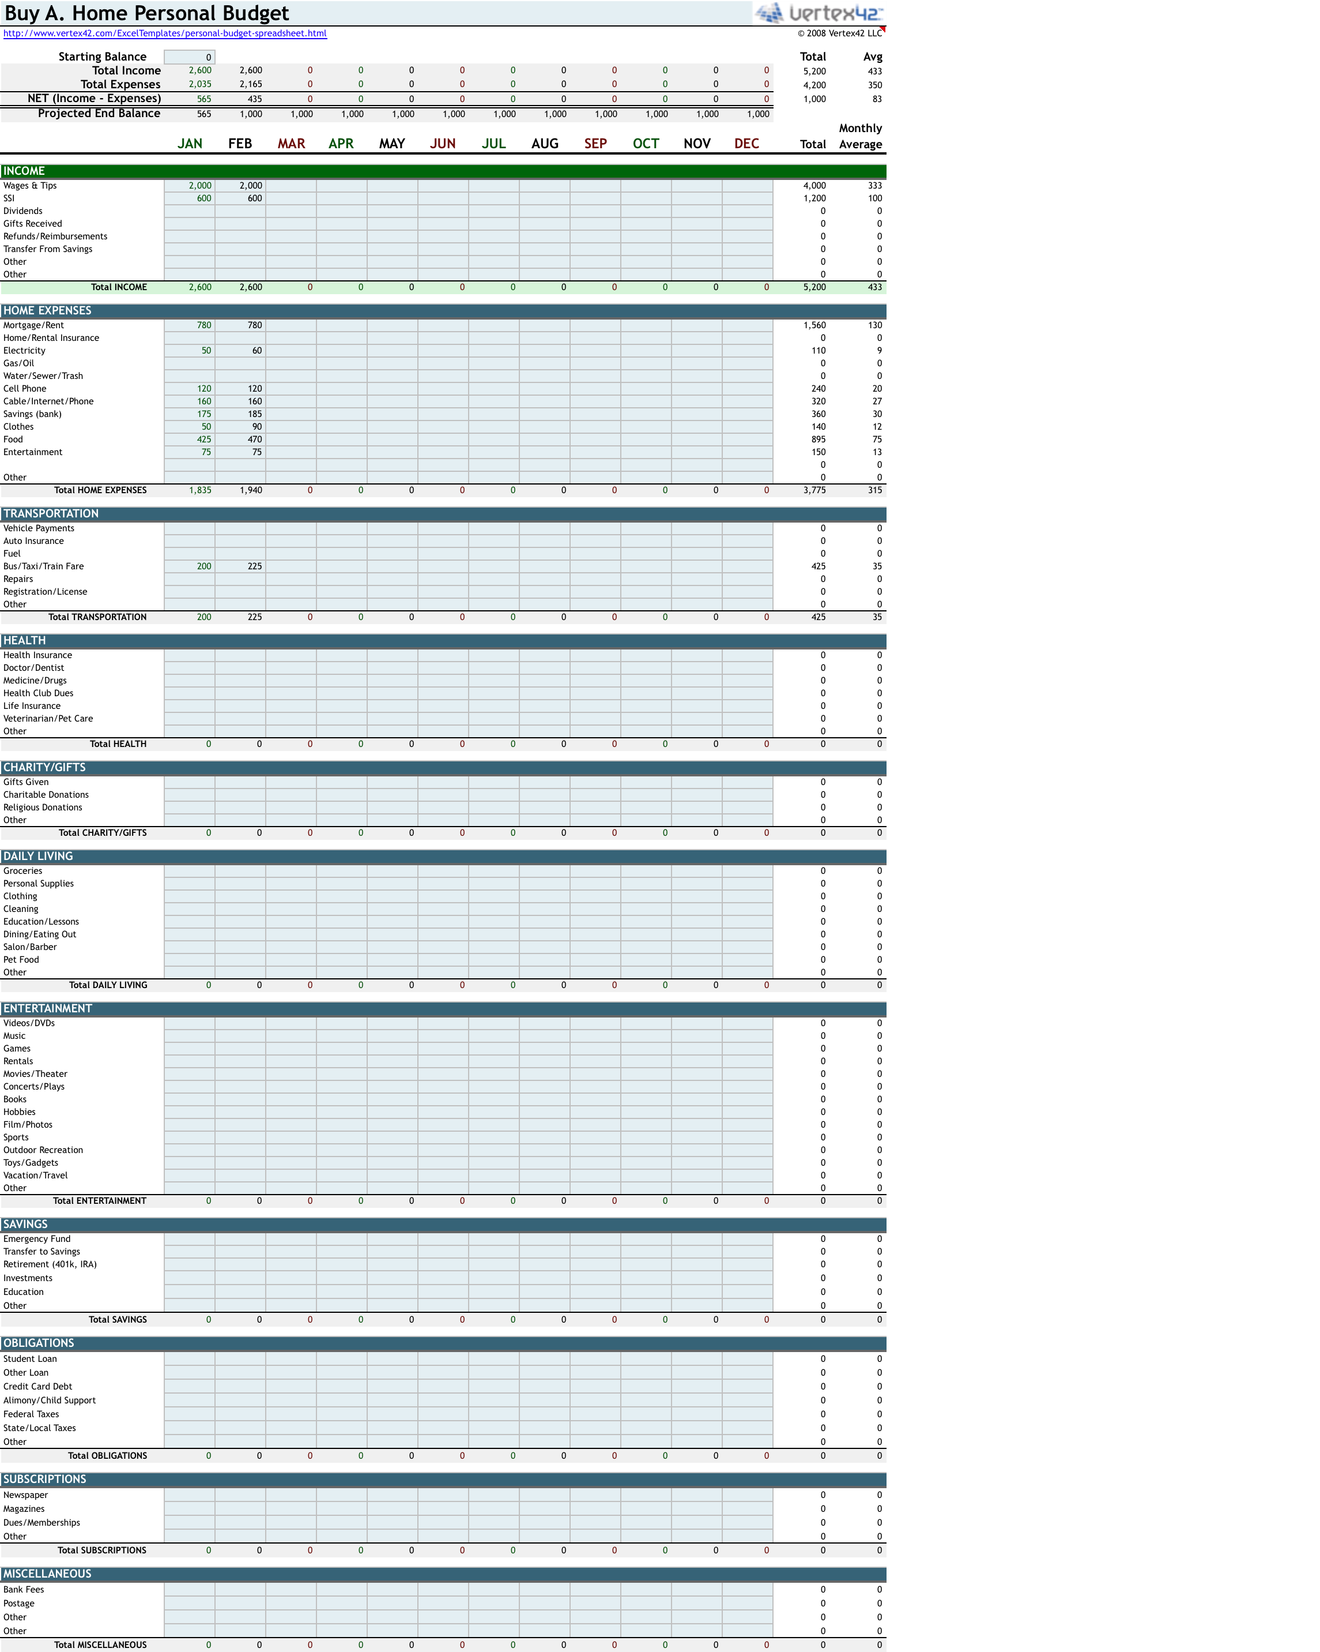
Sample Excel Budget Worksheet

Slide 6
Learning To Live Within Your Means
Determine Your Needs & Wants
* Spending mainly on needs, controlling spending on wants, maintains a healthy financial lifestyle.
* Spending on wants with no self control, leads to overspending, very little savings & hinders you from reaching your financial goals.
Question Your Needs & Wants
* Why do I want it?
* Did I set aside enough money in my budget for miscellaneous
spending?
* Is it a must that I have it right now?
* How does this purchase affect my long term financial goal?
* Can I find this or something similar, cheaper, somewhere else?
* How much have I spent on wants so far this month?

Slide 7
Sample Daily Spending Worksheet
Try a Daily Spending Worksheet for a week. On the example below, what could be done different to save money? Identify needs & wants below.
 | Morning 5am–12pm | Afternoon 12pm-5pm | Evening 5pm-Bed
Sunday | Bagel & Coffee - $2 | Church Offering - $10 | Chinese Food - $12.76
Monday | Bagel & Coffee - $2 Newspaper -$.50 | Cheeseburger/ Fries/Soda - $12.95 | $0
Tuesday | Bagel & Coffee - $2 Newspaper -$.50 | Cheeseburger/ Fries/Soda - $12.95 Paid Credit Card - $25 | Supermarket - $125 Paid Cable/Internet/ Phone - $160
 | Morning 5am–12pm | Afternoon 12pm-5pm | Evening 5pm-Bed
Sunday | Bagel & Coffee - $2 | Church Offering - $10 | Chinese Food - $12.76
Monday | Bagel & Coffee - $2 Newspaper -$.50 | Cheeseburger/Fries/Soda - $12.95 | $0
Tuesday | Bagel & Coffee - $2 Newspaper -$.50 | Cheeseburger/Fries/Soda - $12.95 Paid Credit Card - $25 | Supermarket - $125 Paid Cable/Internet/Phone - $160

Slide 8
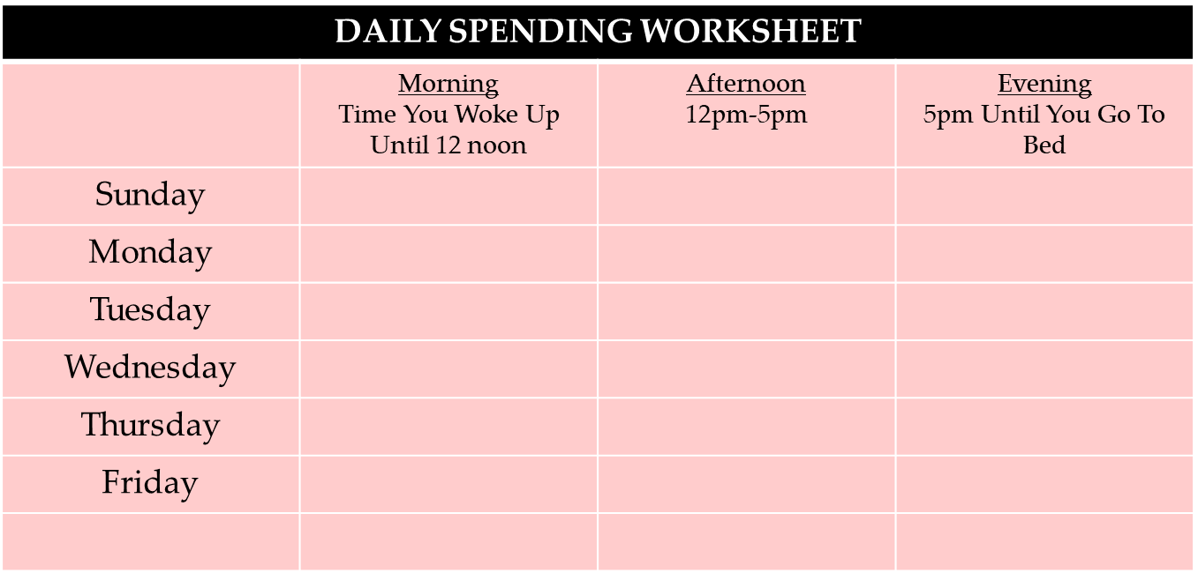
Daily Spending Worksheet Exercise
Instructions: Write down everything you spent money on for the 2 previous days before today’s training. Include money spent on bills, food, transportation, entertainment, loaning money to friends, allowances, etc. write the amount & label it.
Once you’re done, put a circle around what were needs & underline what were wants
Time: 5 minutes filling out worksheet. 10 – 15 minute discussion

Slide 9
Financial Goals
Budgets are established with a specific financial goal in mind.
Financial goals can be saving for a vacation, a car or a HOME.
Once you’re in your home, then a budget should be established to
maintain your home, your lifestyle & to pay your MONTHLY BILLS.
A well-maintained budget keeps your financial goals manageable.
He who fails to plan, is planning to fail – Winston Churchill

Slide 10


Will You Control Your Finances or Will They Control You?
Money is a “Bad Master”, but it is a “Good Servant”. If you’re spending more than you make, then the money is controlling you. If you spend less than you make & save money, you control the money!!!

Slide 11
Budgeting Tips
Focus on savings – Determine how much you can take from your income & put into savings.
Use cash Instead of credit cards. Try to set aside enough money to last until your next check.
Pay down your debts – Using your credit card less or not at all & paying off your cards will help with saving money.
Keep your receipts – Save your receipts, write down the places where you spend your money. (Daily spending sheet)
Balance your checkbook – Make sure you’re not writing checks for money you don’t have in the bank.
Analyze your spending – Go through your budget & receipts. Look for ways to cut down your spending.
Keep emergency cash at home – Keep small amounts of cash at home for little things that may come up.

Slide 12
SAVINGS
Savings is part of your assets. It is the portion of your income not spent on
current expenses. Without savings, unexpected events can become large
financial burdens. Savings can help you and your family be more financially
secure.
Savings are used to purchase expensive items that are too costly to purchase
using monthly income.
Even if you’re not planning on buying a big-ticket item or saving for a vacation,
you still should have savings to cover emergencies. Ideally, you should have 6
months worth of expenses in your savings.
If possible, 10% to 20% of your net income should go into savings.
If you are saving to buy a home, saving doesn’t stop once you’ve purchased
your home.

Slide 13
Budgeting & Savings
Review
Question
&
Answers

Slide 14
PASS PLAN
Plan to achieve self-support
Social security administration

Slide 15
What is a PASS?
It is an SSI provision to help individuals with disabilities return to work.
If you receive SSI or could qualify for SSI after setting aside income or resources so you can pursue a work goal, you could benefit from a PASS.
PASS lets a disabled individual set aside money and things he or she owns to pay for items or services needed to achieve a specific work goal.
The objective of the PASS is to help disabled individuals find employment that reduces or eliminates SSI or SSDI benefits.

Slide 16
How does PASS work?
The applicant finds out what training, items, or services they need to reach a work goal.
A PASS can include supplies to start a business, school expenses, equipment and tools, transportation, uniforms and other items or services you need to reach your employment goal.
The applicant finds out how much these items and services will cost.
PASS can help the participant save to pay these costs. PASS lets persons with disabling conditions set aside money for purchases, installment payments and down payments for things like a vehicle, wheelchair, or a computer if needed to reach their work goal.

Slide 17
How do you set up a PASS?
Decide on your work goal and determine the items and services necessary to achieve your work goal.
You can get help in setting up plan from a vocational rehabilitation (VR) counselor; an organization that helps people with disabilities; Benefits Specialists or Protection and Advocacy organizations who have contracts with us; Employment Networks involved in the Ticket to Work program; your local Social Security office; or anyone else willing to help him or her.
Contact local SSA office; SSA work site or third parties shown above to get a PASS form (SSA-545-BK) to complete.
Bring or mail it to the Social Security office.
We usually approve plans prepared by VR.
If your goal is self-employment, you must also submit a business plan.

Slide 18
The PASS Plan works differently for SSI and SSDI recipients
SSI: If a beneficiary wants to do a PASS Plan, they will first need to get a job. Here’s how it works. Say you earn $885 of wages for a month. Social Security doesn’t count the first $85, and then divides the remaining $800 by 2, leaving $400 in countable earned income (885–85 = 800; 800/2 = 400).
Normally your SSI check would be reduced by $400, but with the PASS Plan, you use that $400 to help pay for business related expenses only. So instead of just getting your SSI check of $733 (or other state amount) you could get that check and your wages of $885. So for the first month you could get $1718 in income in this example! ($400 would go towards the PASS Plan.)
from: disabledworkersusa.com

Slide 19
SSI and SSDI recipients (cont)
SSDI: You would receive 2 checks which would both go to your bank account. Your current SSDI would be used to pay for your business-related expenses. You would then get an additional SSI check of $733 (or other state amount) to cover your living expenses.
Combo SSI and SSDI: You would use you SSDI portion to pay for your goal, and your SSI would be increased to the full amount of $733, (depends on your state SSI amount).
from: disabledworkersusa.com

Slide 20
What happens to the PASS?
We send the PASS to agency employees who we have trained to work with PASS.
A PASS expert works directly with the applicant. The PASS expert looks over the plan to see if the work goal is reasonable.
We review the plan to make sure that the applicant needs the items and services listed on the PASS to achieve his or her work goal and that the items are reasonably priced.
If the plan needs changes, the PASS expert discusses the changes with the applicant.
If we do not approve the PASS, the applicant can appeal the decision

Slide 21
A Plan to Achieve Self-Support (PASS) must:
Be in writing
Preferred on form SSA-545.
Signed by the individual, and, if applicable, the representative payee.
You must have income other than SSI or resources that you can use to pay plan expenses.
You must receive SSI or qualify for SSI after setting aside income or resources so that you may pursue a work goal.
Attainment of your work goal must reduce or eliminate SSI or SSDI benefits.
Must be specific (e.g., carpenter, computer programmer).
Can be a Vocational assessment of your skills and abilities designed to help you select your work goal.
"Getting a degree" or "buying a car" are not acceptable goals.
Reasonable chance of achieving goal, considering strength and abilities.

Slide 22
A Plan to Achieve Self-Support (PASS) must: (cont.)
Have a reasonable time frame - projected beginning and ending dates.
have milestones indicating interval steps.
Last step must indicate how you will obtain your job.
Include expenses that are necessary to achieve the work goal.
Must have additional expenses other than everyday living expenses.
Expenses must be reasonably priced.
Major expenses (e.g., vehicle) can be paid through down payment and installment payments.
Expenses must be paid by the beneficiary with income other than SSI or with resources that are above the SSI resource limit. See Spotlight on Resources.
We may increase your SSI benefits after you set aside funds in your PASS, but no more than the maximum SSI payment amount.

Slide 23
If your work goal is to be self employed
Include a detailed business plan with your application if you want to start your own business. Your business plan should explain:
• What type of business you want to start (for example, a restaurant, a print shop).
• Where you will set up your business (for example, rent a store, share space).
• Your hours of operation.
• Who your customers, suppliers and competitors will be.
• How you will advertise your product or service.
• What items and services you’ll need to start the business.
• What these items and services will cost.
• How you are going to pay for these items and services.
• Your expected earnings for the first four years of the business

Slide 24
Pass cadre
New York Region
PASS Cadre Location | Jurisdiction | Toll-free Number | Local Number
Rochester, NY | Upstate NY (WNY, Central New York, Finger Lakes, Northern Counties, Mohawk Valley, Capital District and Southern Tier) | 855-248-0232 | 866-331-6759, ext. 25811
New York, NY | New Jersey, Downstate New York | PASS A-M 866-348-5403, ext. 23648 PASS N-Z 866-348-5403, ext. 23645 | 866-335-1089

Slide 25
resources
Sample pass plans https://transition.ruralinstitute.umt.edu/employment/ssa-work-incentives/sample-pass-plans/
Information, assistance https://www.passonline.org/
Pass information https://www.ssa.gov/disabilityresearch/wi/pass.htm
Business expenses (pub. 535 irs) https://www.irs.gov/publications/p535

Slide 26
55-b/c Programs
The Governor's Programs to Hire Individuals and Veterans with Disabilities
New York

Slide 27
OVERVIEW
The Governor's Programs to Hire Individuals and Veterans with Disabilities consist of two specialized programs: the 55-b and the 55-c Program. These programs are coordinated efforts to place individuals with disabilities in entry-level state jobs.
Section 55-b of the New York State Civil Service Law authorizes the New York State Civil Service Commission to designate up to 1,200 positions normally filled through competitive examination to be filled through the appointment of qualified persons with disabilities. Section 55-c authorizes the designation of up to 500 positions in the non-competitive class to be filled by qualified veterans with disabilities. In general, an entry-level position that is filled only through an open-competitive examination (one open to the public) may be used for a 55-b or 55-c appointment.
No initial written examination is required for appointment. To qualify for either program, you must first submit a formal application. A medical evaluation may be necessary for program certification.
Please note that Sections 55-b and 55-c are distinct from of the Civil Service Law Section 55-a, which provides similar employment opportunities for individuals with disabilities to positions in local government

Slide 28
PROGRAM ELIGIBILITY REQUIREMENTS
Eligibility pursuant to Sections 55-b and 55-c of the Civil Service Law is limited to persons with physical or mental disabilities, who are found otherwise qualified to satisfactorily perform the duties of a position. Employee Health Service at the Department of Civil Service will evaluate the degree of functional limitations*, restrictions, and need for special accommodation.
A serious limitation in a functional area means a reduction, due to a severe physical or mental impairment, to the degree that the individual requires services or accommodations not typically made for other individuals to prepare for, enter, engage in, or retain employment.
If you were previously approved for either program but your eligibility has expired, please contact the 55-b/c Program.
Email: SSDRecruitServices@cs.ny.gov
Phone: (518) 473-8961 or (866) 297-4356

Slide 29
ELIGIBILITY
Do I need to take a test?
You will not need to take a written civil service test or examination to qualify for a position. However, you will need to meet the minimum qualifications for the job, and you might also need to take additional tests, depending on the position. For example, some jobs require a candidate to pass a physical ability test or a language proficiency test. You are still encouraged to take civil service examinations, which can lead to more job opportunities with the State.

Slide 30
HOW TO APPLY
To apply for the 55-b/c Program, you must submit a completed application, along with the following documents:
Resume
DD-214 - Certificate of Release or Discharge from Active Duty (a DD-214 can be requested through the U.S. National Archives and Records Administration
VA rating decision letter
If you are a veteran and do not have your DD-214 form available, your application will be processed as a 55-b application. However, once you obtain your DD-214 and meet the criteria as a veteran, you may request to change your status from 55-b to 55-c.
Once you are approved for the 55-b or 55-c Program, you will receive a 55-b or 55-c letter of eligibility. Your program eligibility is effective for three years from the date on the letter. After three years, if you wish to continue your eligibility, you may contact program staff and request an extension.

Slide 31
55-b/c Recruitment Resources Program Portal
The 55-b/c Recruitment Resources Program Portal provides a centralized location for qualified candidates to submit up-to-date employment and contact information for consideration by State agencies filling entry-level positions.
55-b/c Program candidates can use the portal to:
Submit contact information (including academic and occupational details) and employment or job location preferences
Upload a resume
Access to the 55-b/c Recruitment Resources Program Portal is limited to candidates with a 55-b/c letter of eligibility. https://www.cs.ny.gov/rp55/pre-login.cfm
You will need a personal NY.gov ID to access the information. If you do not have a personal NY.gov ID, please create an account.
55B APPLICATION

Slide 32
RECRUITMENT
How do I find a job?
Upon receiving your 55-b/c eligibility letter, a candidate should create a user ID and password on the 55-b/c Recruitment Resources Portal.
To increase your opportunities for employment with New York State through competitive examination, you can:
Review our examination announcements https://www.cs.ny.gov/jobseeker/
Internship Opportunities with NYS https://nysinternships.cs.ny.gov/nnyl/
Access current job openings https://careermobilityoffice.cs.ny.gov/cmo/gotit/
Visit the Glossary Of Titles - Inquiry Tool https://careermobilityoffice.cs.ny.gov/cmo/gotit/
Schedule an appointment with the Department of Labor's One-Stop Career Services Center https://dol.ny.gov/career-centers

Slide 33
What types of positions are available through these programs?
Agencies use the 55-b/c Program to fill entry-level positions. In general, an entry-level position that is filled only through an open-competitive examination (one open to the public) may be used for a 55-b or 55-c appointment.
Entry-level positions are defined as any position/title for which an open-competitive examination is held and any existing promotion list has been exhausted.
A candidate must:
Possess the minimum qualifications for the selected title as established by the Department of Civil Service
Meet the applicable minimal mental and/or physical requirements for the job (with a reasonable accommodation, if necessary)

Slide 34
How do I get appointed?
Review current vacancies open to the general public online(on Recruitment page). When you review a specific job or vacancy, confirm you meet the minimum qualifications for the position. If you meet the qualifications and are interested in applying, follow the instructions on the "contact" tab in the vacancy announcement. When you submit your resume and letter of interest to the hiring agency, be sure to include a copy of your 55-b/c eligibility letter.

Slide 35
CIVIL SERVICE CONTACTS
Nichole Harden Diversity & Inclusion Specialist 2 518-473-8691 Nichole.Harden@cs.ny.gov
LaShanna S. Frasier Diversity & Inclusion Specialist 3 518-549-2318 LaShann.Frasier@cs.ny.gov

Slide 36
55-a
WORKERS WITH DISABILITIES
In accordance with Section 55-a of the Civil Service Law, individuals with disabilities may be eligible for employment in certain positions in local governments (counties, cities, towns, and villages), without having to take a written examination.

Slide 37
Application Process
In order to be employed under Section 55-a in local government positions, individuals with disabilities should apply directly to the employer for any entry-level position for which they meet the required minimum qualifications.
A nomination for appointment to a position pursuant to Section 55-a must be made by the appointing authority to the local civil service commission or Personnel Officer if the employer is interested in appointing an individual with a disability.
The local Civil Service Commission or Personnel Officer will request the position duties and responsibilities be reviewed by either the New York State Commission for the Blind (NYSCB), or the State Education Department (SED) https://www.acces.nysed.gov/vr/public-employers to determine if the nominee is able to perform the duties of the position.
If the nominee is able to perform the job duties of the position, the NYSCB or SED will certify to the local civil service agency that the nominee is eligible for appointment.
Note that while certification by these organizations is required to be employed under Section 55-a, such certification is not a guarantee of a job. For more information regarding Section 55-a, you should contact the local civil service agency having jurisdiction over the position.

Slide 38
Each local civil service agency in New York State (State) may, by rule, determine a prescribed number of positions (not to exceed 700) with duties which can be performed by persons with physical or mental disabilities who are found qualified to perform such duties satisfactorily.
Each local civil service agency has policies and procedures regarding appointments pursuant to Section 55-a. Depending on the local civil service agency's policies and procedures, it is typically an employer's prerogative whether to appoint an entry-level competitive class position from an open-competitive civil service examination eligible list or to appoint a qualified person with a disability on a non-competitive basis.
Please note that Section 55-a is distinct from Sections 55-b and 55-c of the Civil Service Law, which provide similar employment opportunities for individuals with disabilities to positions in State government.

