Slide 1
VOTING
(Almost) Everything You Need to Know

Slide 2
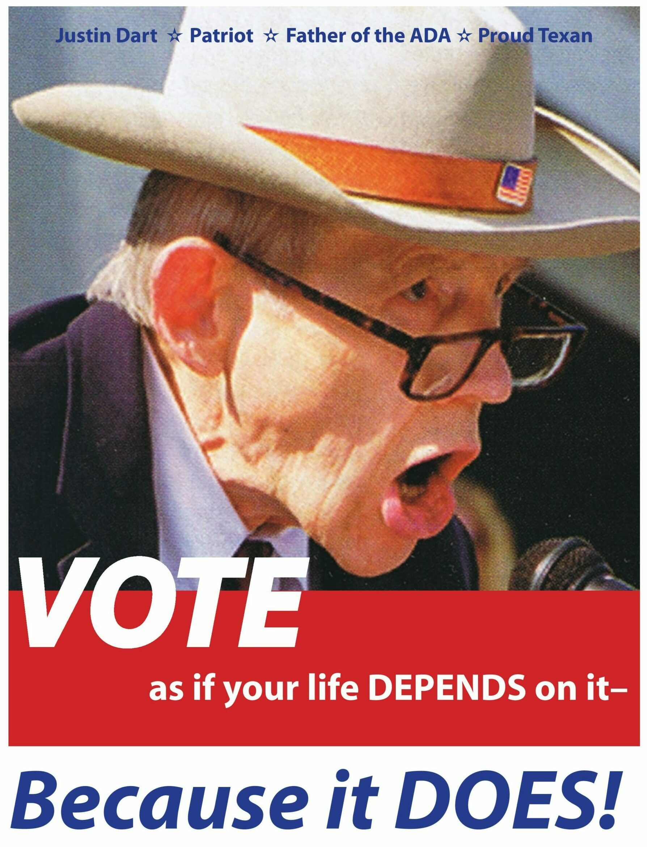
Why vote?
There are an estimated 38 million eligible voters with disabilities.
Local elections matter too!
*Projecting the Number of Eligible Voters with Disabilities in the November 2020 Election (September 24, 2020) – Dr. Lisa Schur and Dr. Douglas Kruse, Rutgers University https://smlr.rutgers.edu/sites/default/files/schur_kruse_disability_electorate_projections.pdf

Slide 3
Voter Rights
Vote privately and independently
An accessible polling place
Use of an accessible voting machine (ballot marking device)
Get help with voting from a person of your choice
except your employer or union representative
Vote by absentee ballot
Request a provisional ballot

Slide 4
VOTER REGISTRATION DEADLINE
Saturday, October 28, 2023
ABSENTEE BALLOT APPLICATION DEADLINE
Monday, October 23, 2023

Slide 5
Voter Eligibility
US Citizen
At least 18 years old
Live at current address for at least 30 days before the election
Change of address must be filed by October 23, 2023
Can only be registered at one address
Not in prison for a felony conviction
You can vote while on probation or parole.
You can vote if you’ve completed a sentence for a felony.
Only a judge can make the decision that someone is not competent to vote
Notes:
This can seem like a lot of information. If you have any questions about your eligibility to vote, talk to me or your local board of elections office.

Slide 6
Voter Eligibility
Guardianship status alone does not determine eligibility status.
“No person who has been adjudged incompetent has the right to vote, unless later adjudged competent.” NYS Election Law Sec. 5-106 (6)
“Receipt of services for mental disability shall not deprive persons of the right to register and vote is otherwise qualified.” NY Mental Hygiene Law Sec. 33.01
“The commissioner shall include rules and regulations…for community residence a statement of the rights of persons living in such residences which shall include…the right to vote’ and the right to participate in activities that educate persons with developmental disabilities in their civic responsibilities.” NY Mental Hygiene Law Sec. 41.41
Notes:
This can seem like a lot of information. If you have any questions about your eligibility to vote, talk to me or your local board of elections office.

Slide 7
Options for Voting
1) Absentee voting (also known as vote-by-mail)
2) Early voting
3) On Election Day

Slide 8
1) Absentee Voting
https://absenteeballot.elections.ny.gov/
Request absentee ballot and return completed ballot ASAP (Deadline – October 23, 2023)
Be mindful of USPS collection times
If you request an absentee ballot, you must vote using the absentee ballot
You can vote in-person by affidavit ballot, which will be counted if they do not receive your absentee ballot

Slide 9
2) Early Voting
Early Voting: October 28 – November 5, 2023
Polls are open for 9 days before every Election
Starts 10 days before, and goes until 2 days before (1 day break between early voting and General Election Day)
Not all polling places are open. Check with your Board of Elections office to find out what polling places are open.
Check with your Board of Elections office for polling place hours.

Slide 10
3) Election Day
https://voterlookup.elections.ny.gov/
General Election: November 7, 2023
Polls Open: 6AM – 9PM

Slide 11
VoterLookup.Elections.NY.gov

Slide 12
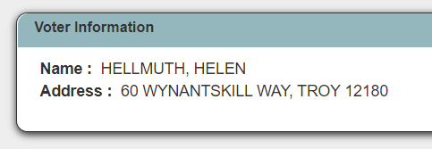
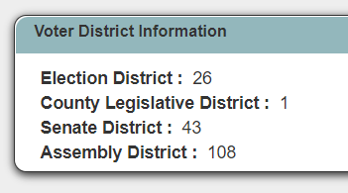
VoterLookup.Elections.NY.gov

Slide 13
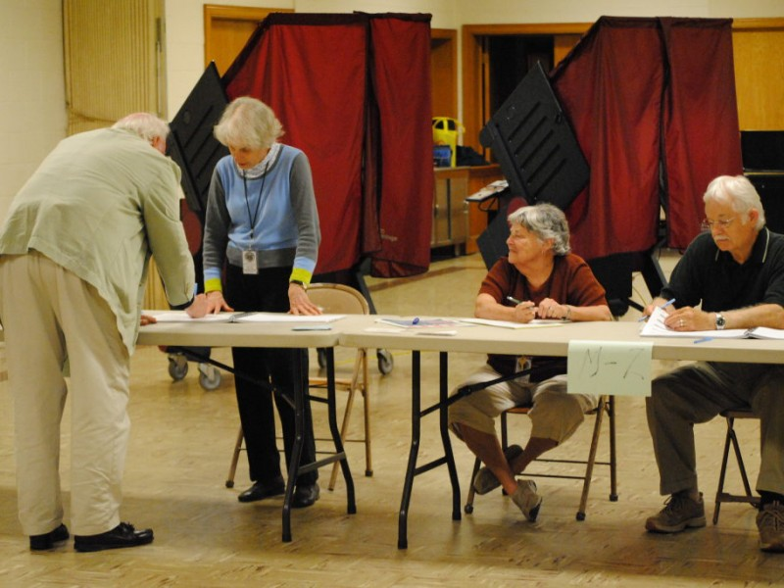
STEP 1: CHECK-IN TABLE
Sign name in poll book
Pick up your ballot
Notify poll worker if you need assistance

Slide 14
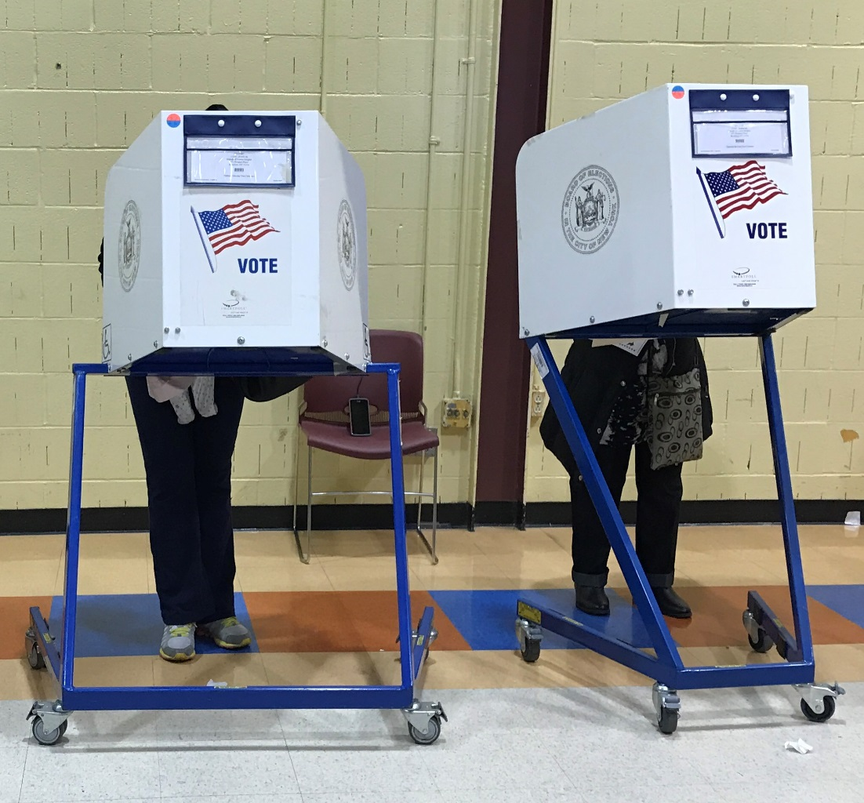
STEP 2: MARK YOUR BALLOT
Carefully read ballot (front and back)
Mark ballot
Ask poll worker if you have any questions

Slide 15
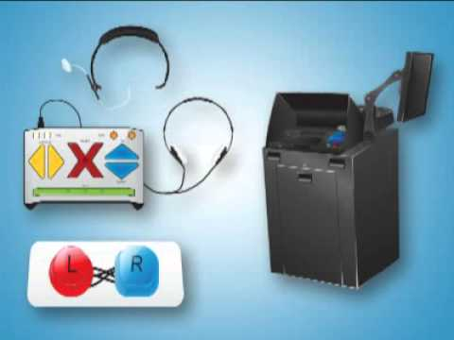
Ballot Marking Devices (BMD)
ES&S AutoMark
Albany, Schenectady, Erie, Rockland, NYC, and Nassau Counties
Dominion ImageCast (or ImageCast Evolution)
All other counties
Notes:
Recommend you contact your local board of elections office to learn more about the machine.
Alternatively, you can contact me directly and I’m happy to have a more in-depth conversation regarding the BMD in your county.

Slide 16
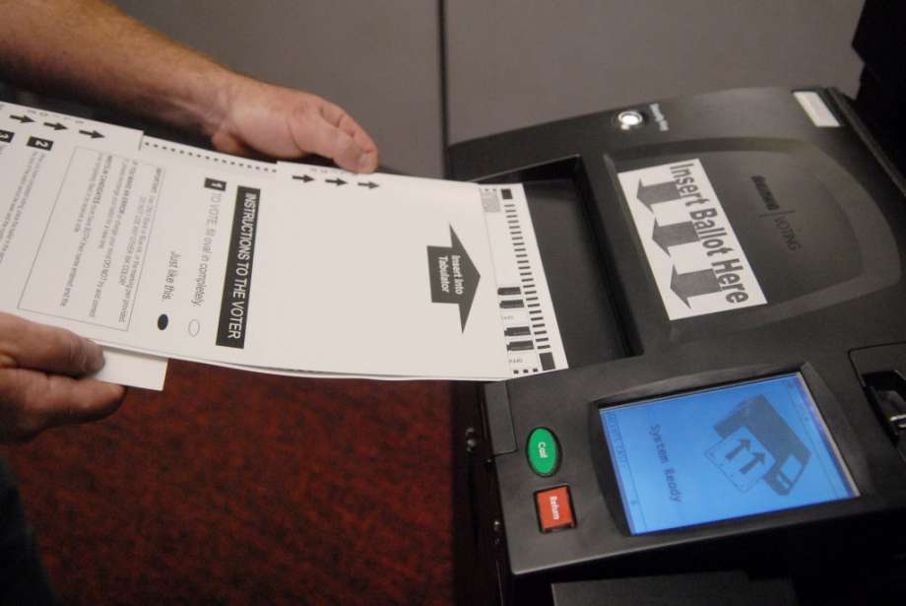
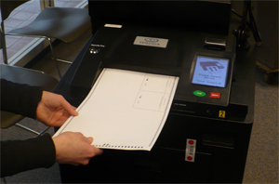
STEP 3: SCANNER
Put marked ballot in scanner to be counted

Slide 17
How To Learn About Candidates
Ballotpedia.org
JustFacts.VoteSmart.org
Vote411.org
FactCheck.org
Candidates Websites

Slide 18
VoteSmart.org

Slide 19
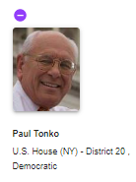
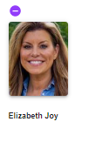
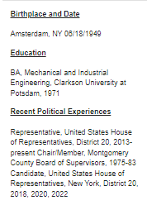
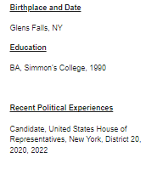

Slide 20
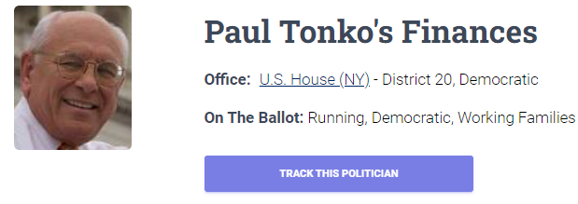
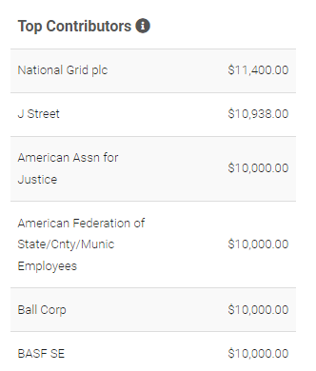
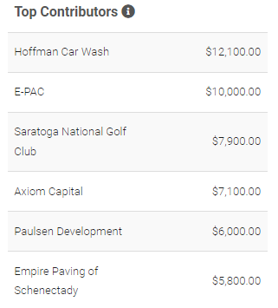
Notes:
Vote Smart is a fantastic non-partisan resource for finding voting information.
You can read bios, positions on issues, their ratings from special interest groups, etc.

Slide 21
How to Get Around Voting Problems
Problem: Your parents don’t want you to vote.
Strategy:
Tell them that only a judge can decide whether or you are allowed to vote.
Talk to your parents about why voting is important to you and that you really want to vote.

Slide 22
How to Get Around Voting Problems
Problem: Someone says they will give you a ride to the polling place, but only if you will vote for the person they want.
Strategy:
Ask someone else to take you.
See if there are other options to get to the polls (e.g. public transportation).
If this is the only ride you can get – let them drive you, ask them to wait outside while you vote, and vote for the person you want.

Slide 23
How to Get Around Voting Problems
Problem: You are in the voting booth and don’t know what to do.
Strategy:
Bring support with you
Ask a poll worker to help
Ask to use the ballot marking device.

Slide 24
How to Get Around Voting Problems
Problem: You make a mistake marking your ballot.
Strategy: Ask a poll worker for a new ballot.

Slide 25
NEED HELP REGISTERING? I CAN HELP!
Jenessa.Seymour@drny.org
518-414-4516

